Slide 1
COE Scaling Exercise and Recommendations
Tyler Mayer
05/03/13

Slide 2
COE vs. Nameplate Rating

Slide 3
COE Options @ CBM 6000

Slide 4
COE Contribution by Area

Slide 5
OPEX Scaling
2.4 MW LRC of 144k is assumed from previous analysis and used to estimate failure rate
Assumes same architecture, design practice and failure rates across configurations
Requires detailed analysis of O&M and LRC to estimate true costs/ COE impact
Scaling is accurate for comparison.

Slide 6
Failure LRC Modeling
Preliminary analysis used only to validate LRC scaling method
Needs full review of failure frequency and costs

Slide 7
Scaling Exercise Recommendations
Scaling exercise shows that a smaller rated machine may is commercially viable.
Recommendation is a single CBM 6000 drivetrain.
This architecture provides:
Configuration similarity to higher ratings
Bearings, Shafts, Seals and Nacelle design can accommodate higher ratings
Room to grow
The single 6000 architecture can increase capacity with the addition of a stacked pump.
Margin to learn
A smaller design will allow headroom for unanticipated loading
Lower cost
A smaller machine will be easier and cheaper to manufacture a prototype.

Slide 8
Prototype Cost Estimates

Slide 9
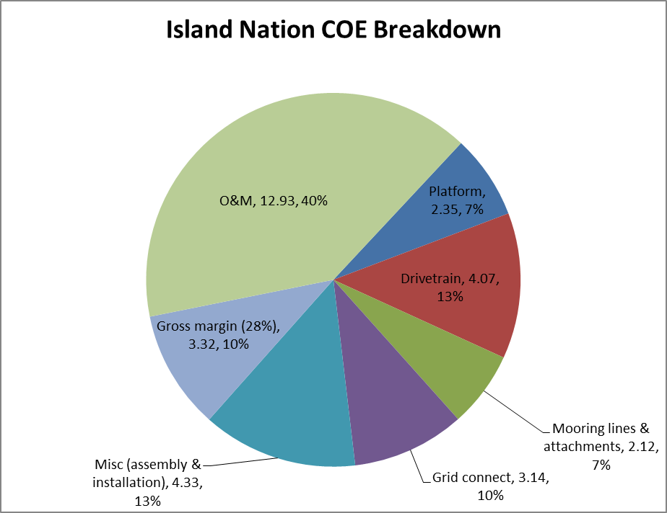
Island Nation Estimate
Assumes 20 - 350 kW Unit Site.
Estimated variable flow Indonesian resource (limited data).
40% AEP loss due to variable resource.
20% increase in drivetrain cost to handle increased torque of variable flow.
Increase in Grid Connect, Installation and O&M due to economies of scale.

Slide 10
DOE FOA Implications
FOA Topic 2 Proposal ($3m)
Develop and Test Fully Integrated CBM 6000 drivetrain at NREL
System control and dynamics
Off axis loading performance
Include Seawater Bearings & Seals with pressure housing
Bearing wear performance under load
Seal performance under pressure and deflection
In collaboration with:
Tom Foley – Hydraulic System Design - ($150k)
BEW – Electrical System Design - ($150k)
Ettem – Seal Design and Supply - ($350k)
University of Florida - Bearing Design - ($250k)
Bosch Rexroth –Hydraulic System Supply - ($1m)
NREL - Test Stand and Support - ($800k)

